Slide 1

dickey-fuller test For airplane passengers prediction
Gilbert Lauren
1806199865

Slide 2
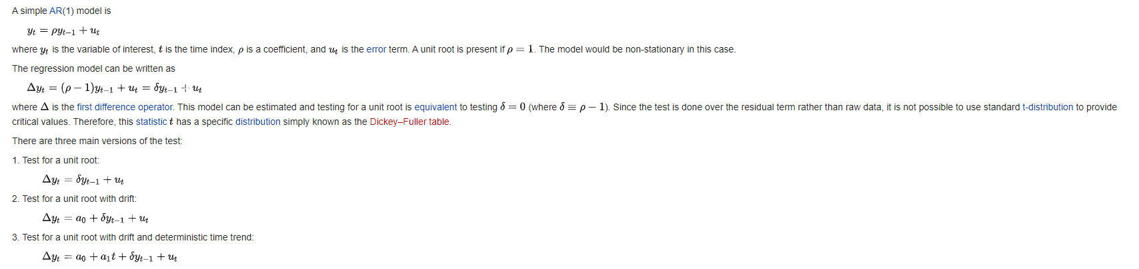
Dickey-fuller test

Slide 3
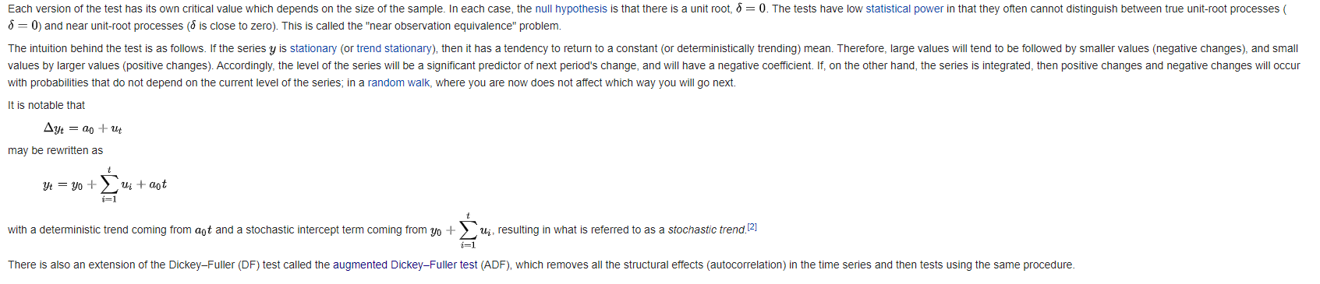

Slide 4
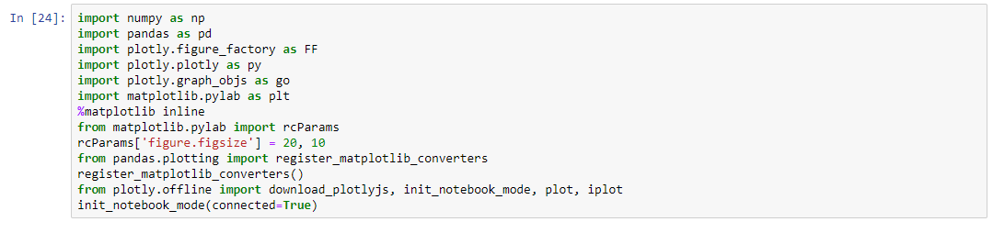
Library yang digunakan
In statistics, the Dickey – Fuller test tests the null hypothesis that a root unit is present in an autoregressive model.
The alternative hypothesis is different depending on which version of the test is used,
but is usually stationarity or trend-stationarity.
It is named after the statistics David David and Wayne Fuller, who developed the test in 1979

Slide 5
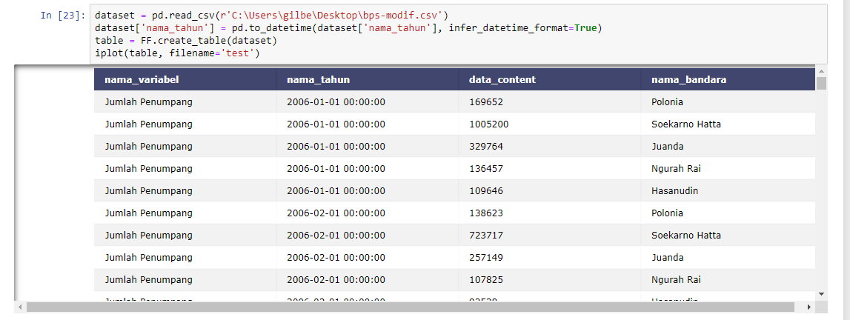
dataframe
Jumlah Penumpang Pesawat di Bandara Utama (Orang) Keberangkatan pada Penerbangan Domestik (5 bandara)

Slide 6
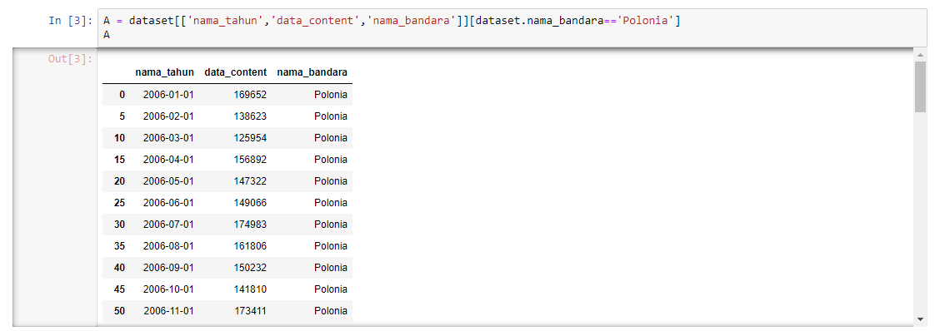
Salah satu sampel bandara Polonia

Slide 7
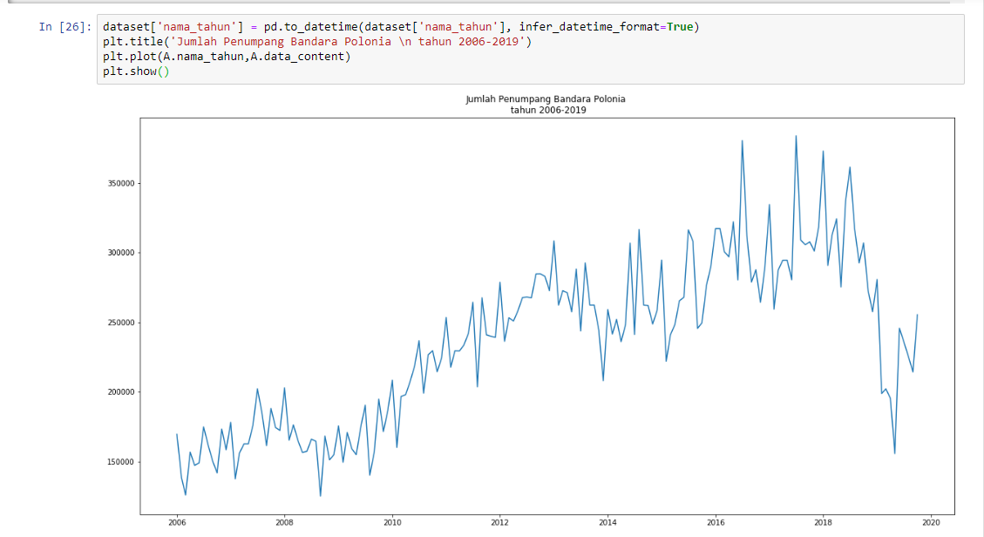
Grafik bandara Polonia 2006-2019

Slide 8
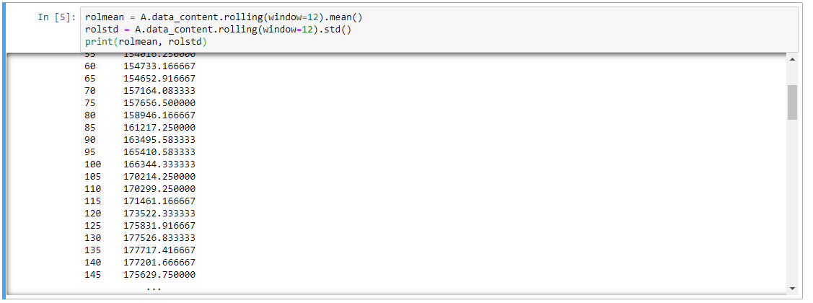
Determing rolling statistics
One of the more popular rolling statistics is the moving average. This takes a moving window of time,
and calculates the average or the mean of that time period as the current value

Slide 9
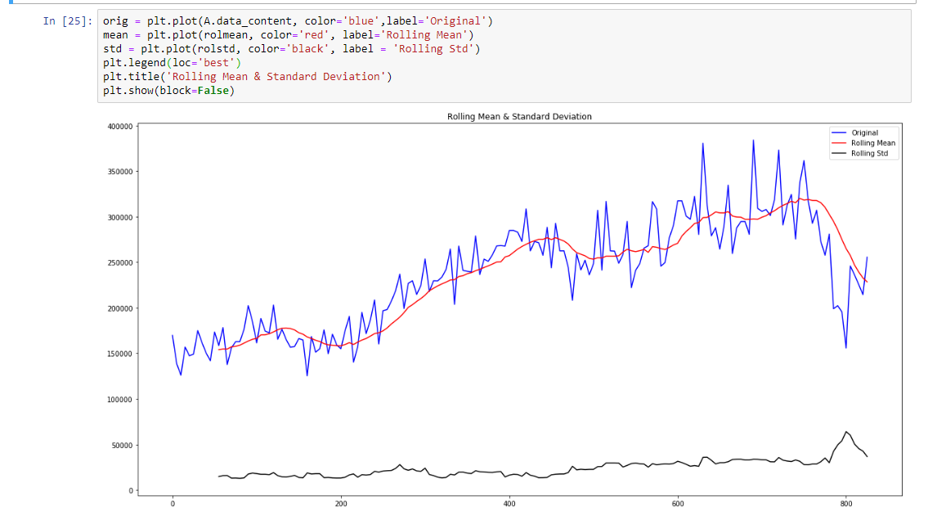
Plot rolling statistics

Slide 10
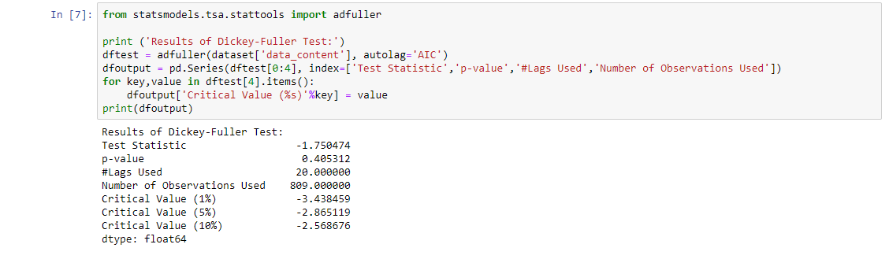
Perform Dickey-Fuller test

Slide 11
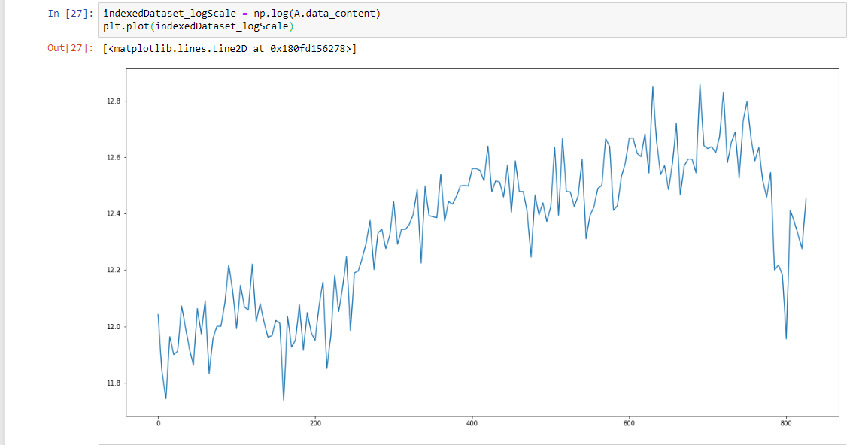
Estimating trend

Slide 12
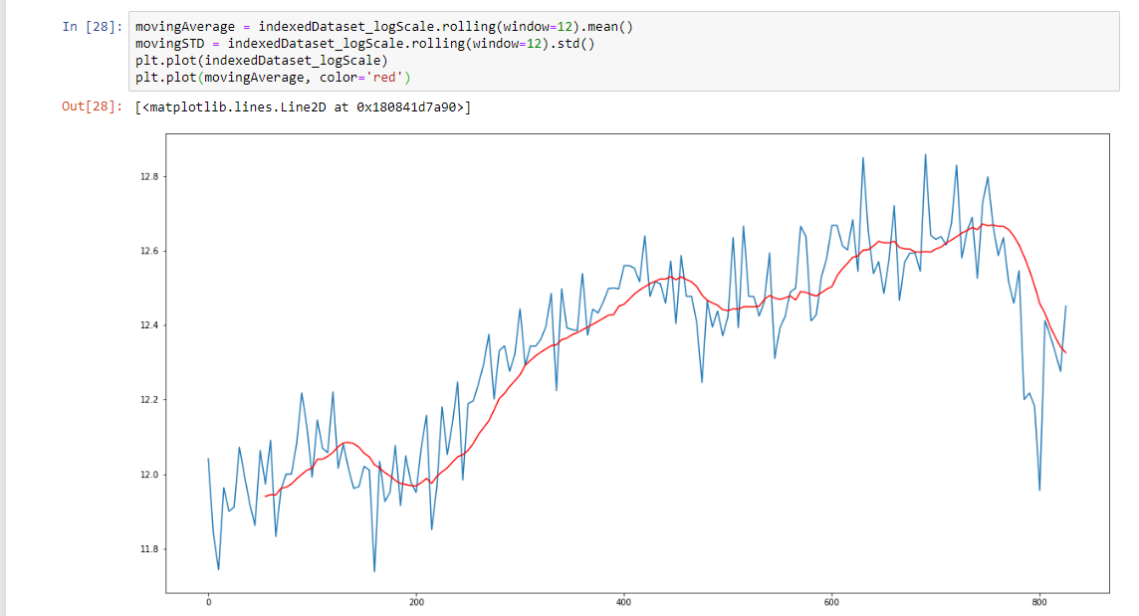
Estimating trend with moving average

Slide 13
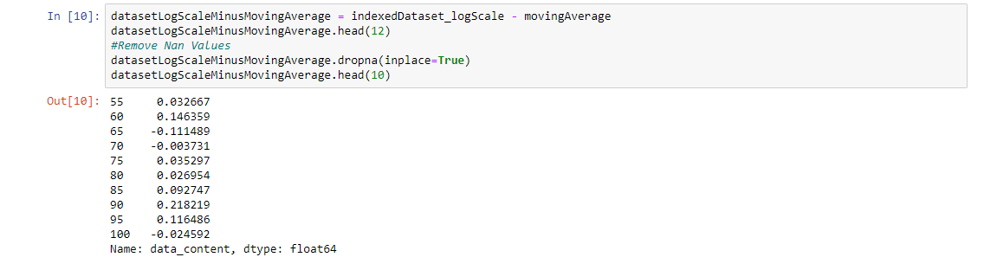
Get the difference between the moving average and the actual number of passengers

Slide 14
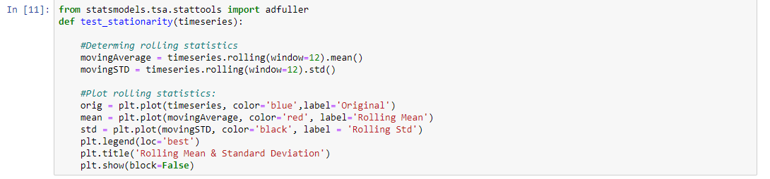
Determing rolling statistics and Plot rolling statistics

Slide 15
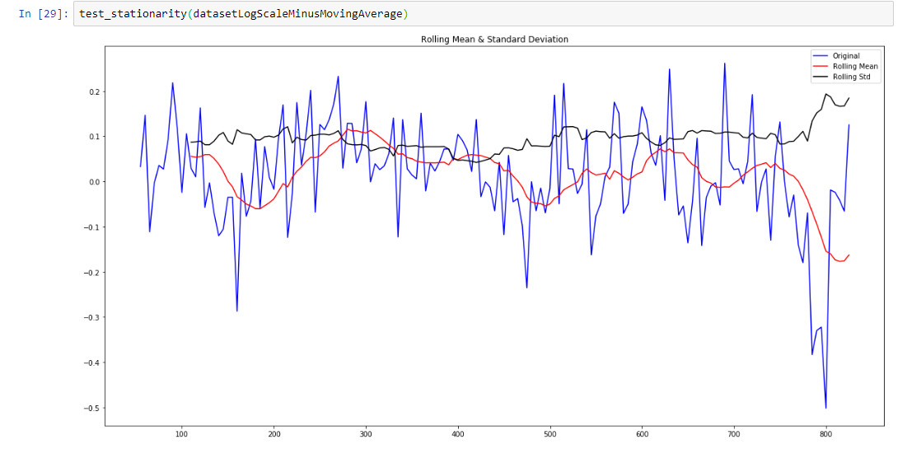
Rolling mean & Standard Deviation

Slide 16
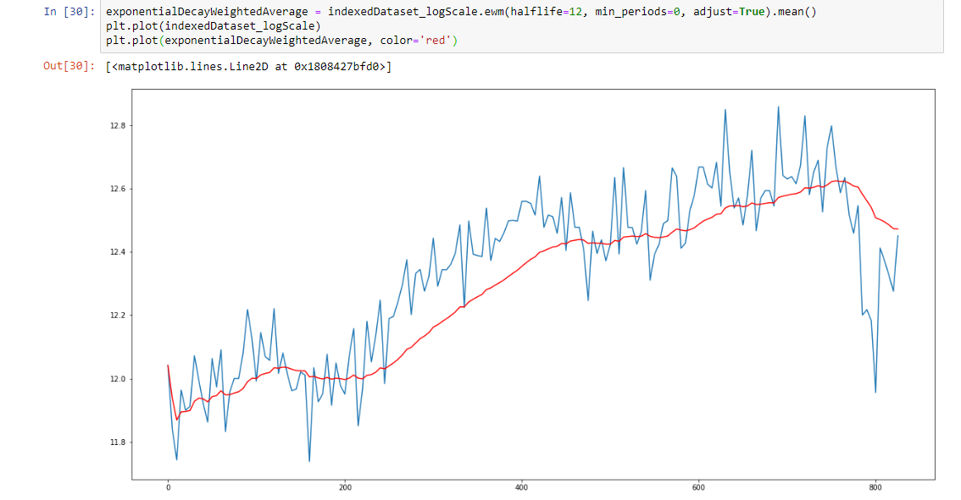
Exponetial Decay Weighted Average
The exponential moving average (EMA) is a weighted average of the last n prices,
where the weighting decreases exponentially with each previous price/period.
In other words, the formula gives recent prices more weight than past prices.

Slide 17
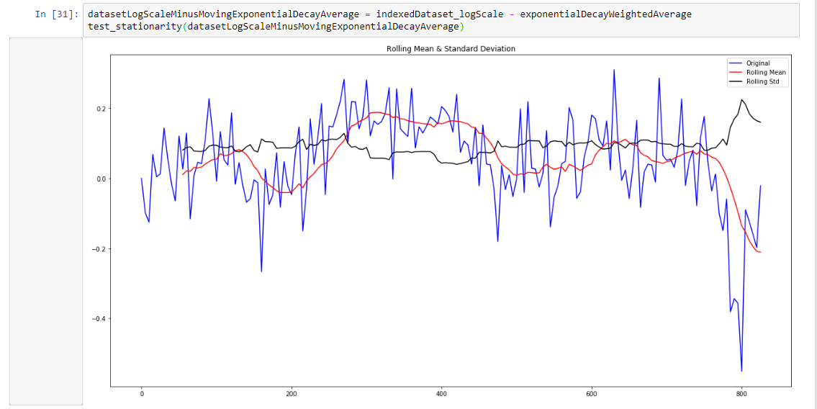
Dataset – Moving Exponential Decay Average

Slide 18
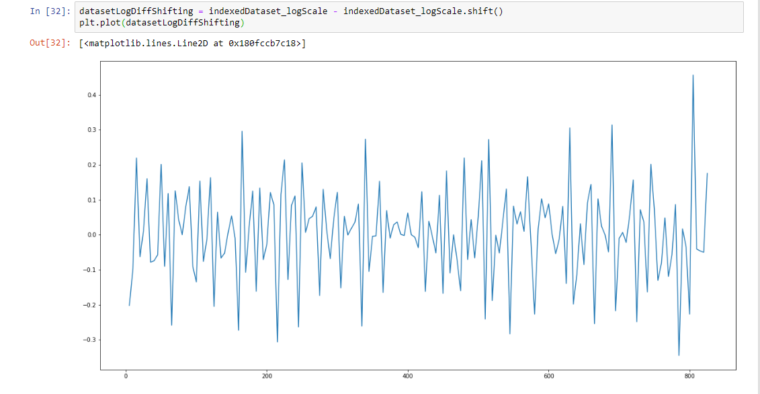
Diff Shifthing

Slide 19
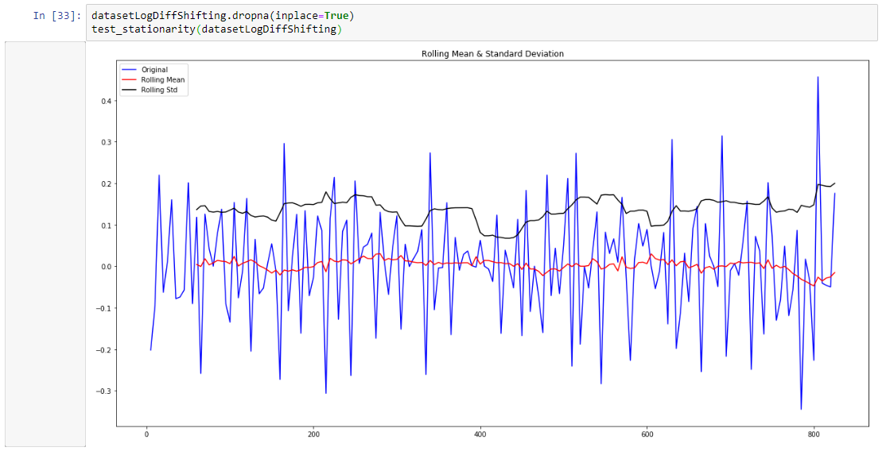
Diff Shifting with Rolling Mean and Rolling Std

Slide 20
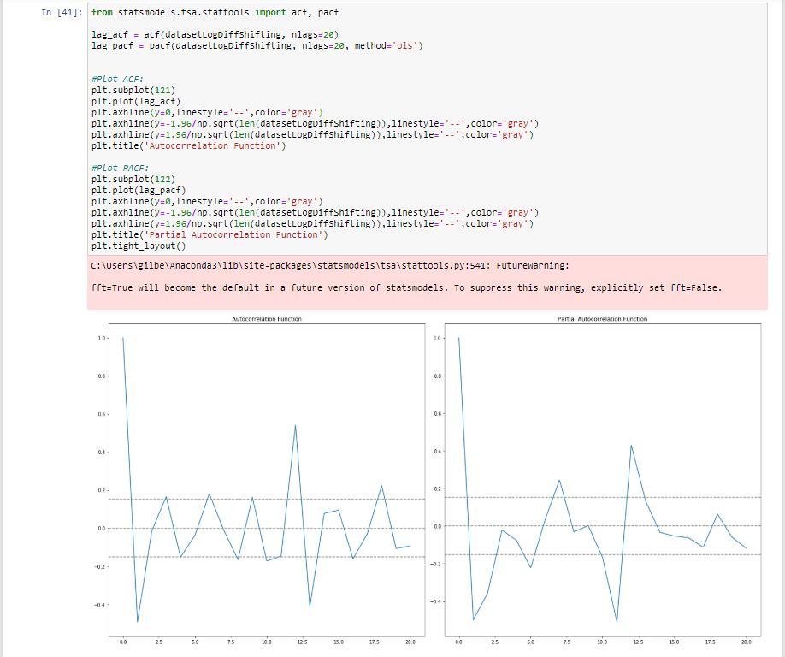
Autocorrelation Function and Partial Autocorrelation Function

Slide 21
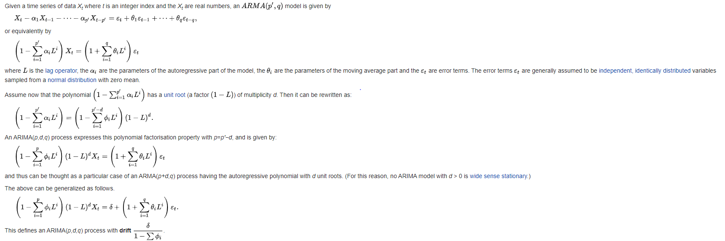
autoregressive integrated moving average (ARIMA)

Slide 22
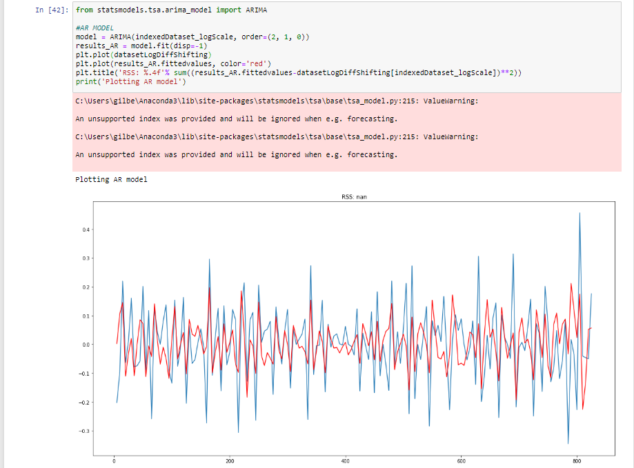
In time series analysis, the Box–Jenkins method, named after the statisticians George Box and Gwilym Jenkins, applies autoregressive moving average (ARMA) or autoregressive integrated moving average (ARIMA) models to find the best fit of a time-series model to past values of a time series

Slide 23
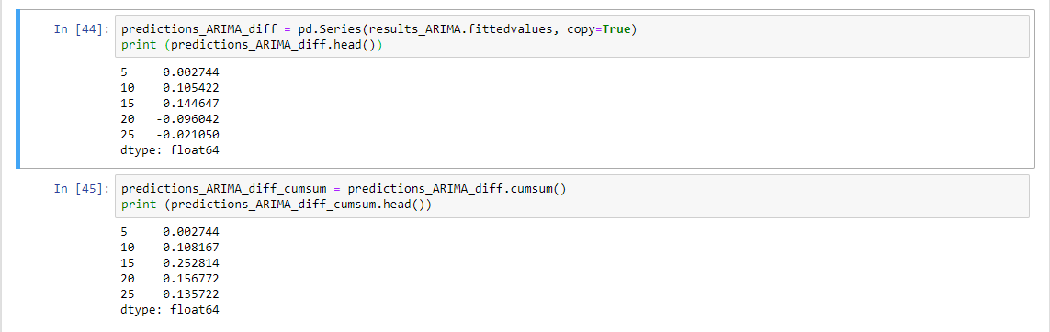
ARIMA models are applied in some cases where data show evidence of non-stationarity, where an initial differencing step (corresponding to the "integrated" part of the model) can be applied one or more times to eliminate the non-stationarity.

Slide 24
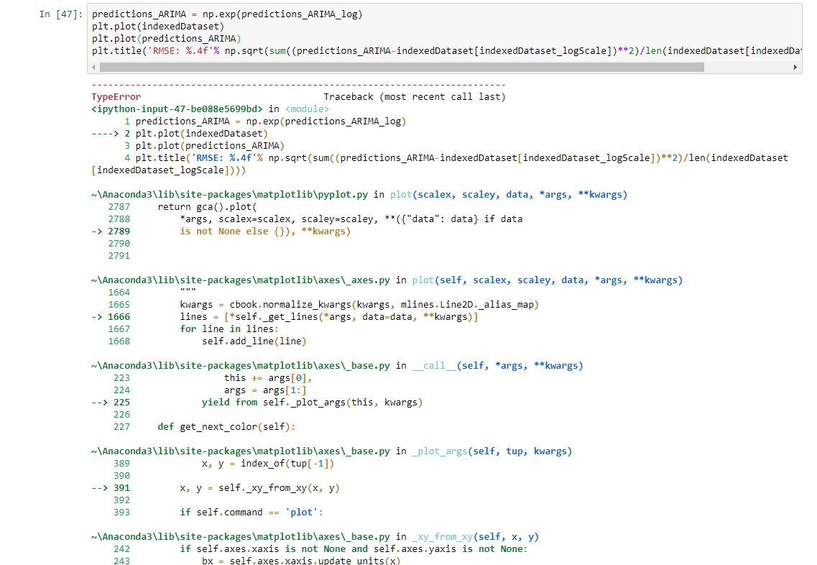
Karena tipe dataframe yang digunakan berbeda, program tidak dapat menghasilkan ARIMA predictions

Slide 25
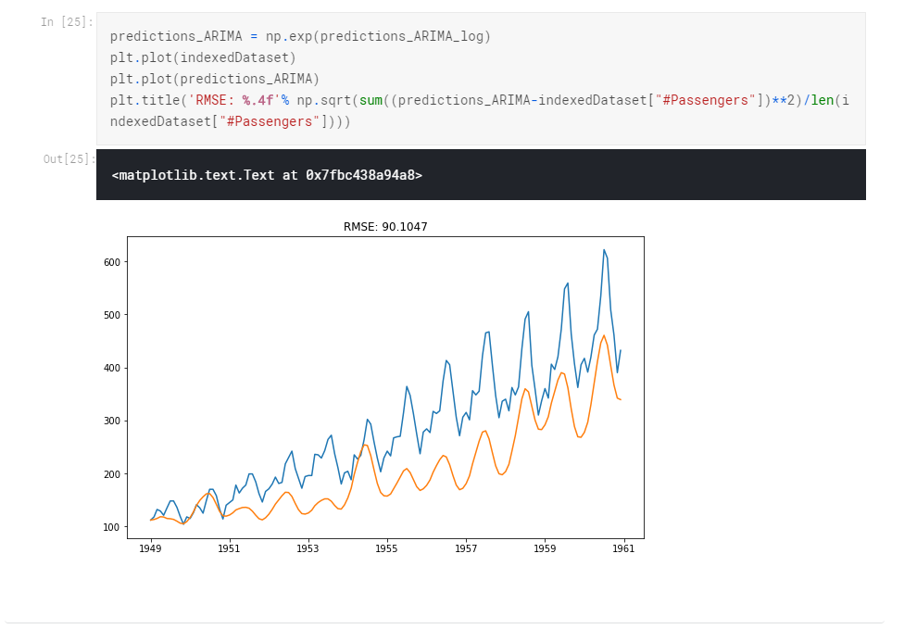
Tetapi hasil yang dihasilkan merupakan seperti ini

Slide 26
Conclusion
Dickey-Fuller digunakan untuk menentukan apakah unit root, fitur yang dapat menyebabkan masalah dalam inferensi statistik, hadir dalam model autoregressive (ARIMA)
Kedua metode tersebut hanya dapat digunakan untuk memprediksi, diluar dari hal-hal tidak terduga seperti kenaikan tiket pesawat, melonjaknya penumpang, atau hal-hal lainnya. tetapi kurang lebih dapat mewakili dilihat dari perkembangannya dari tahun ke tahun.
Pada saat seasonal data menjadi lebih sulit diprediksi karena tidak pasti, tetapi kurang lebih setiap tahun selalu sama
Trend yang terjadi dari tahun ketahun juga selalu meningkat

Slide 27
Link GitHub:
https://github.com/gilbertlauren/Prediksi-kenaikan-penumpang-pesawat
Link Social Media:
https://www.facebook.com/100000287821150/posts/2825278134158420/?d=n

